Slide 1
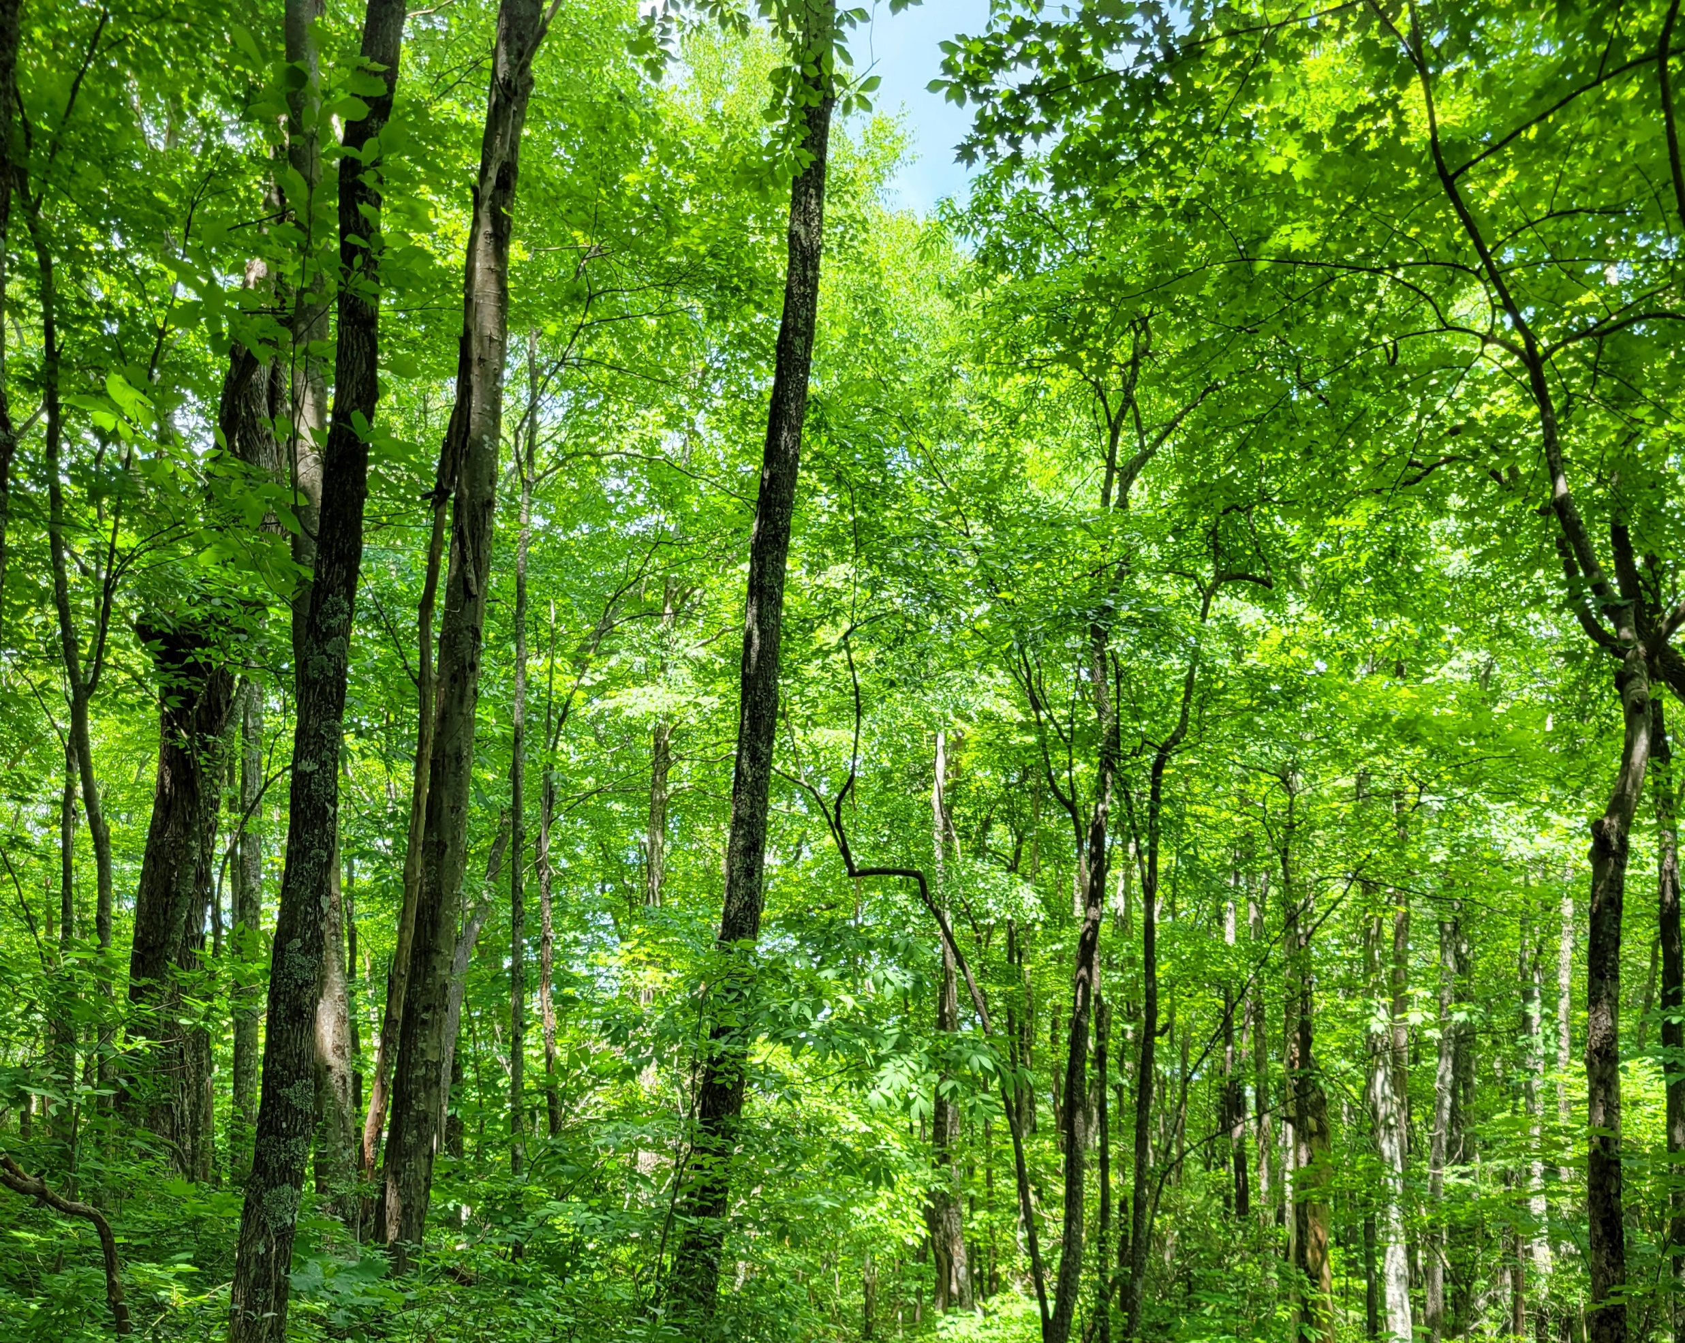
Regulation of nonstructural carbohydrate dynamics
Biological Insights from a Mathematical Analysis
Scott W Oswald, Doug P. Aubrey, Dan M. Ricciuto, Jeff M. Warren
Ecological Society of America, Montréal, QC
August 18, 2022

Slide 2
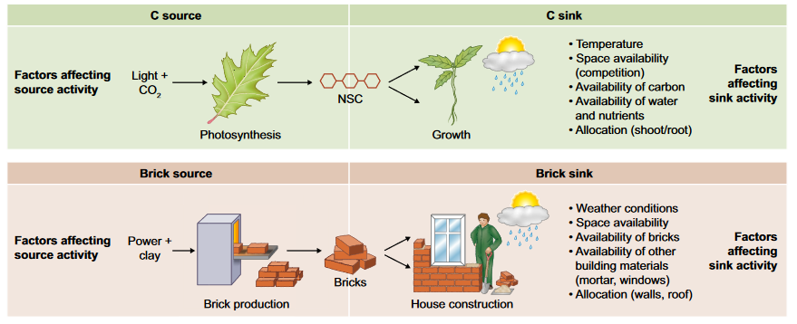
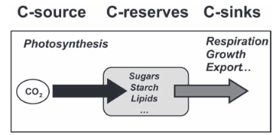
Fig 1. Fatichi et al. 2019
Nonstructural Carbohydrates = NSC
Sala et al. 2011; Sala et al. 2012

Slide 3
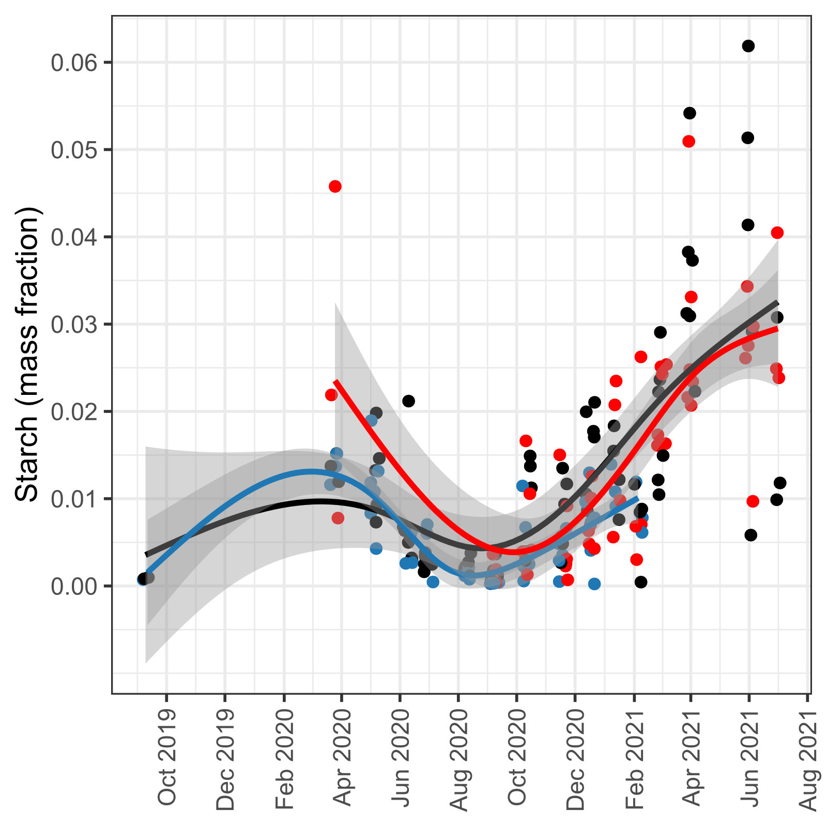
From here to there…

Slide 4
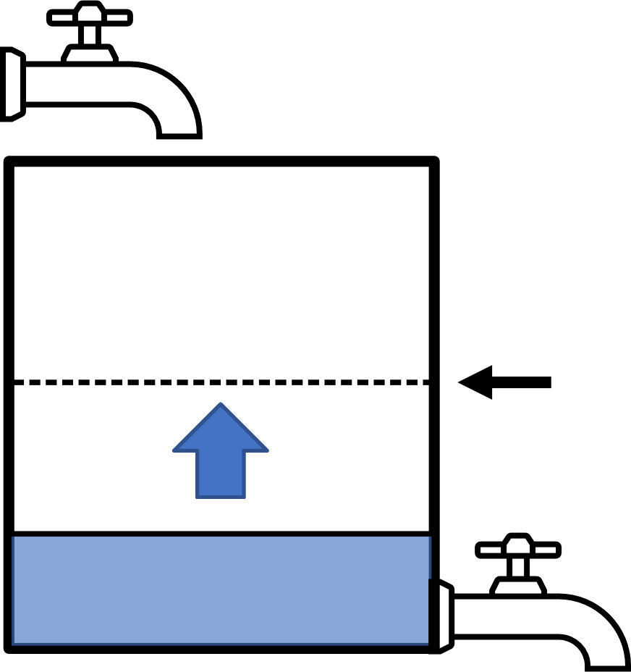
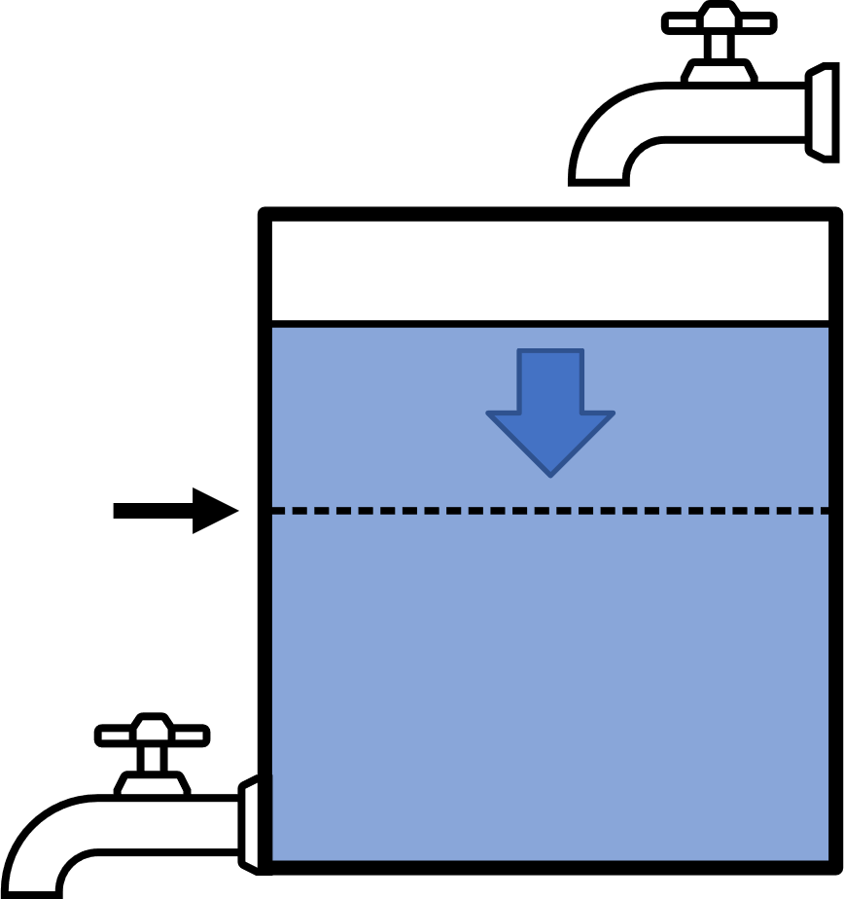
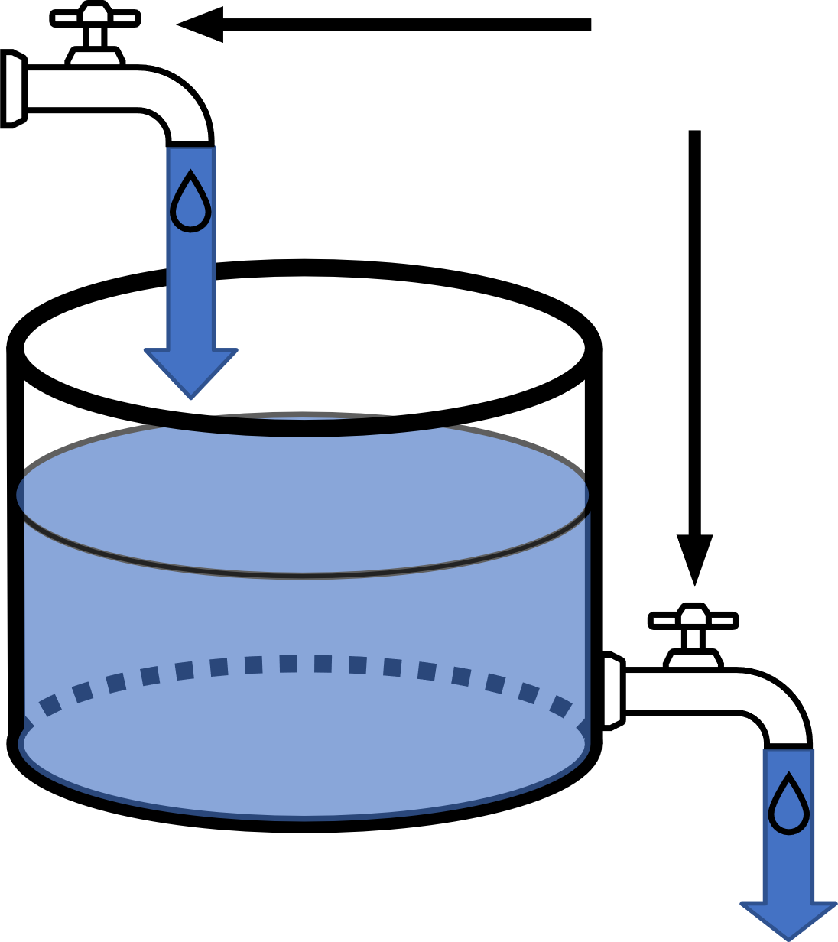
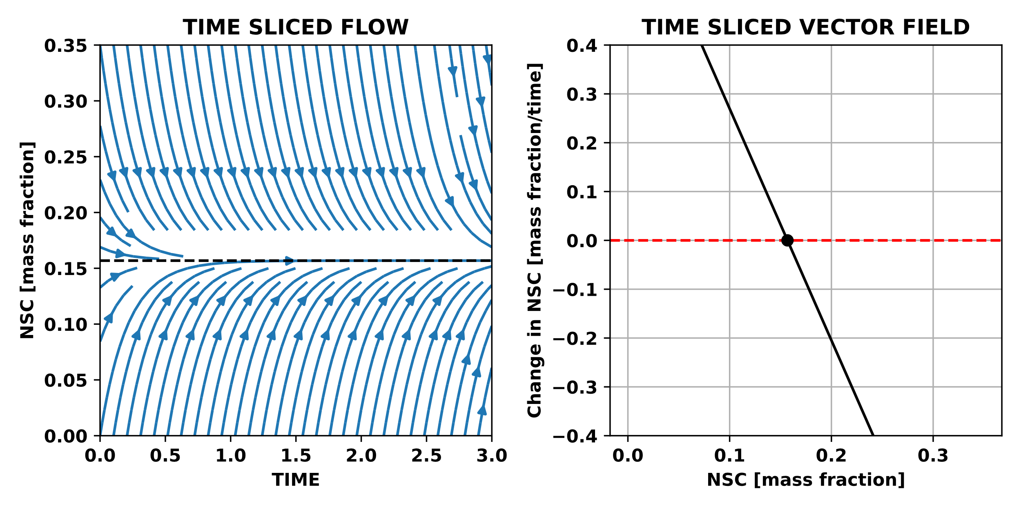
Photosynthesis
Adjustable
Balance point
NSC
Respiration + Growth
Balance point

Slide 5
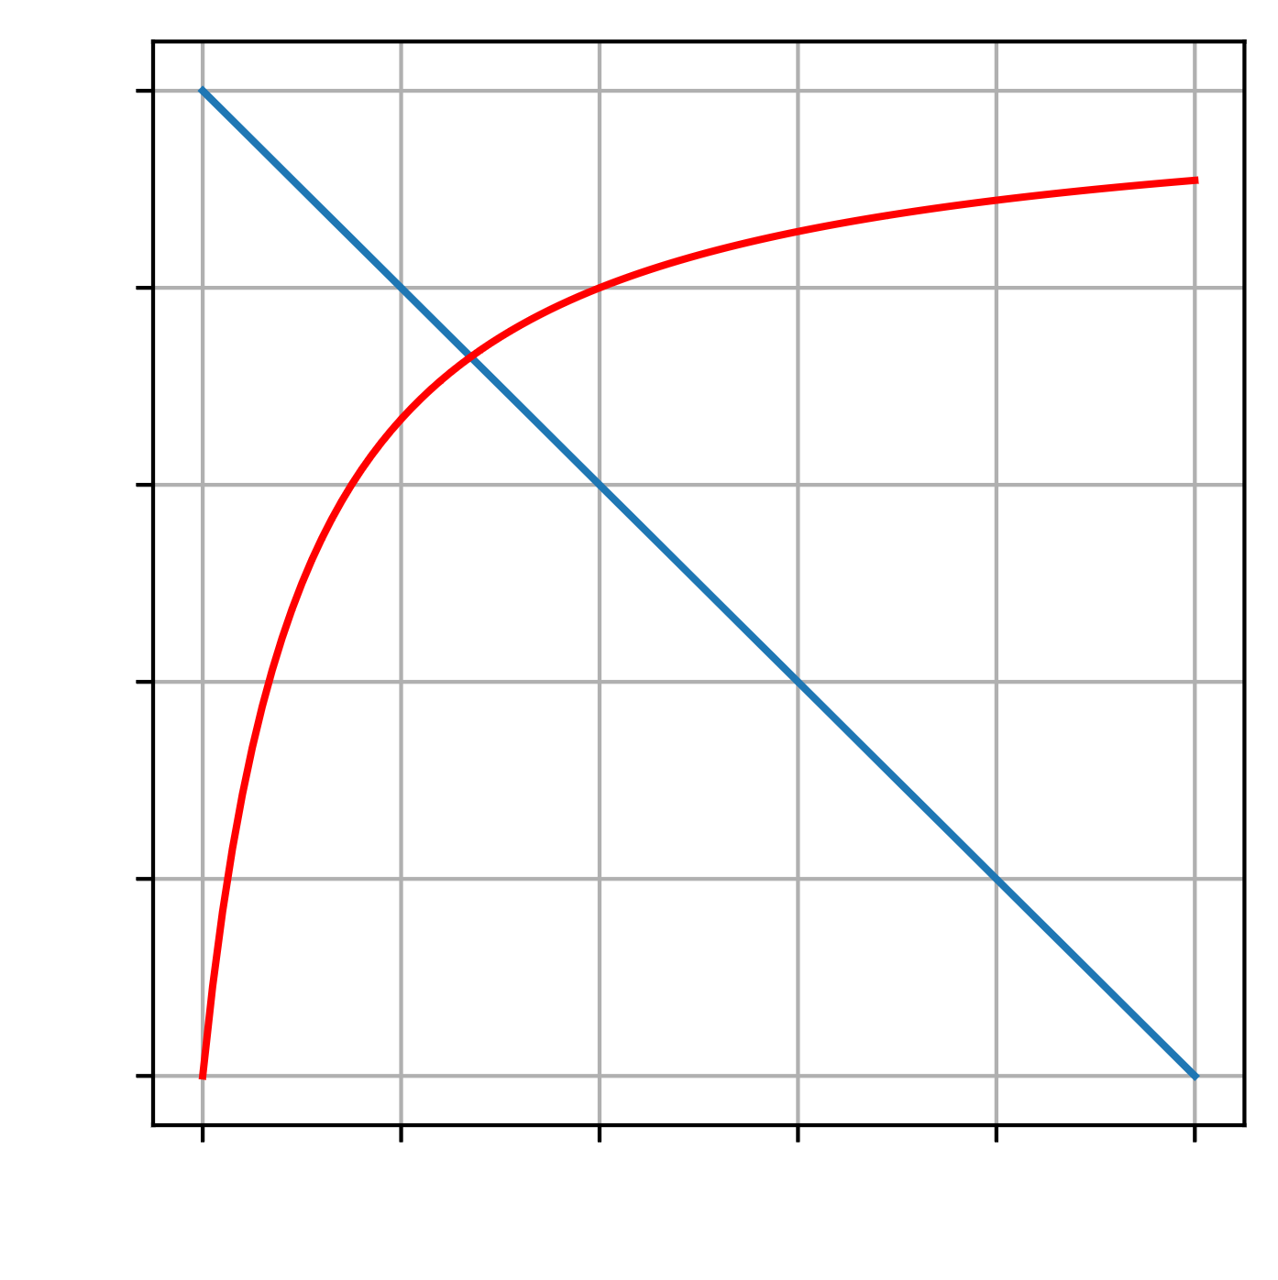
Photosynthesis = Supply
Demand Rate
Adjustable
Rate
Supply Rate
Respiration + Growth = Demand
NSC

Slide 6
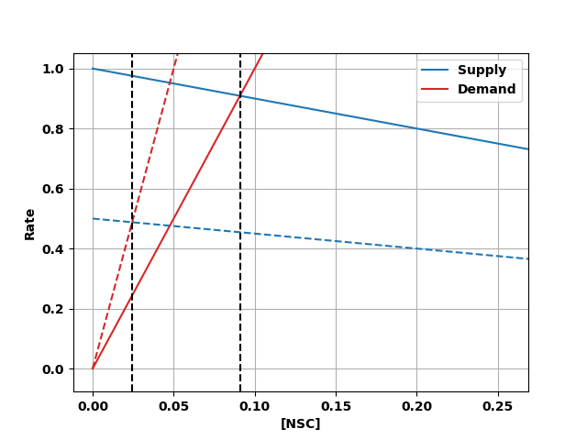
Photosynthesis = Supply
Adjustable
Respiration + Growth = Demand

Slide 7
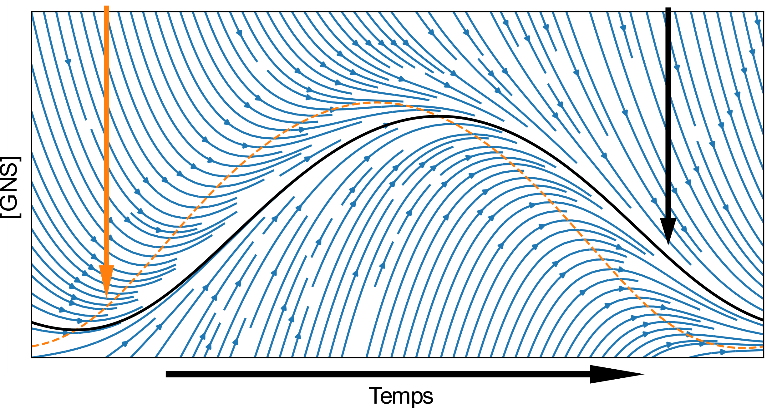
Balance point
Attractor
[NSC]
Time

Slide 8
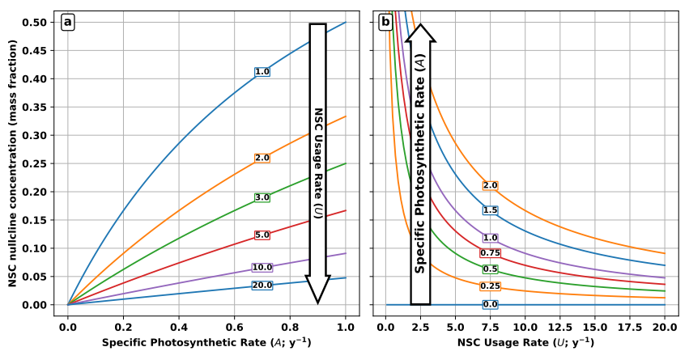
NSC balance point (mass fraction)

Slide 10
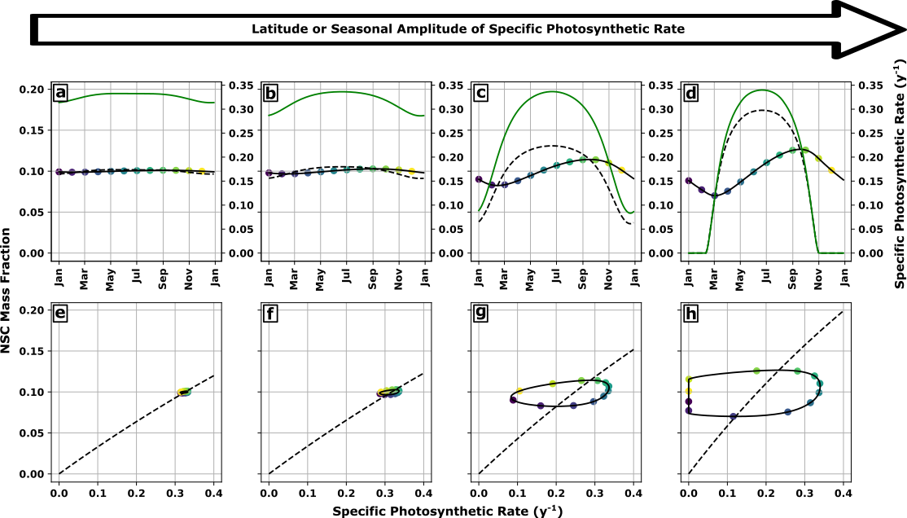

Slide 12
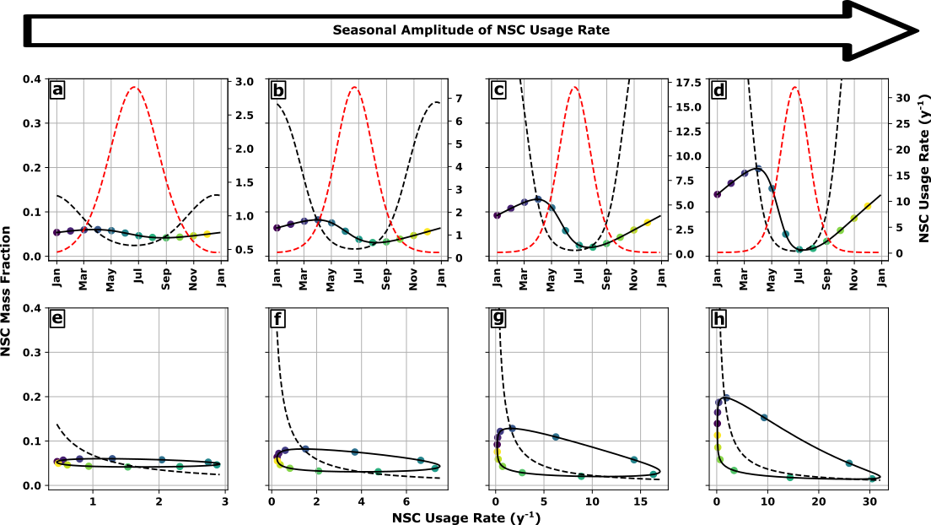

Slide 14
Photosynthesis = Supply
Demand Rate
Adjustable
Rate
Supply Rate
Respiration + Growth = Demand
NSC

Slide 15
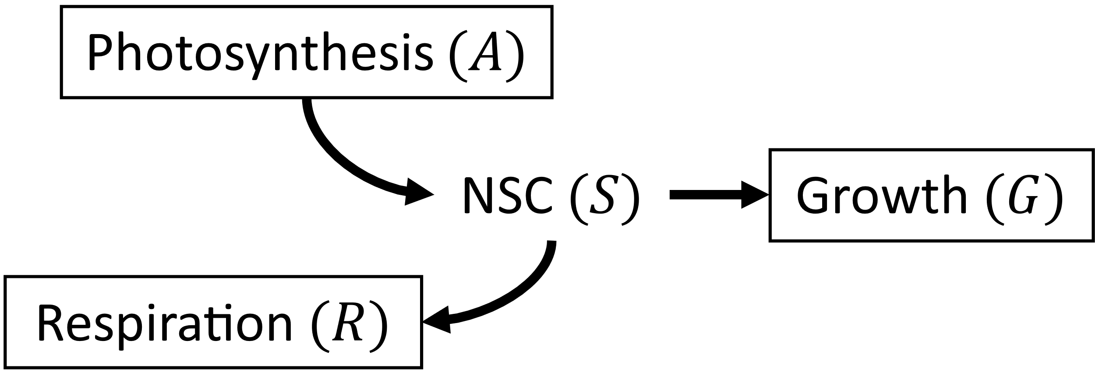
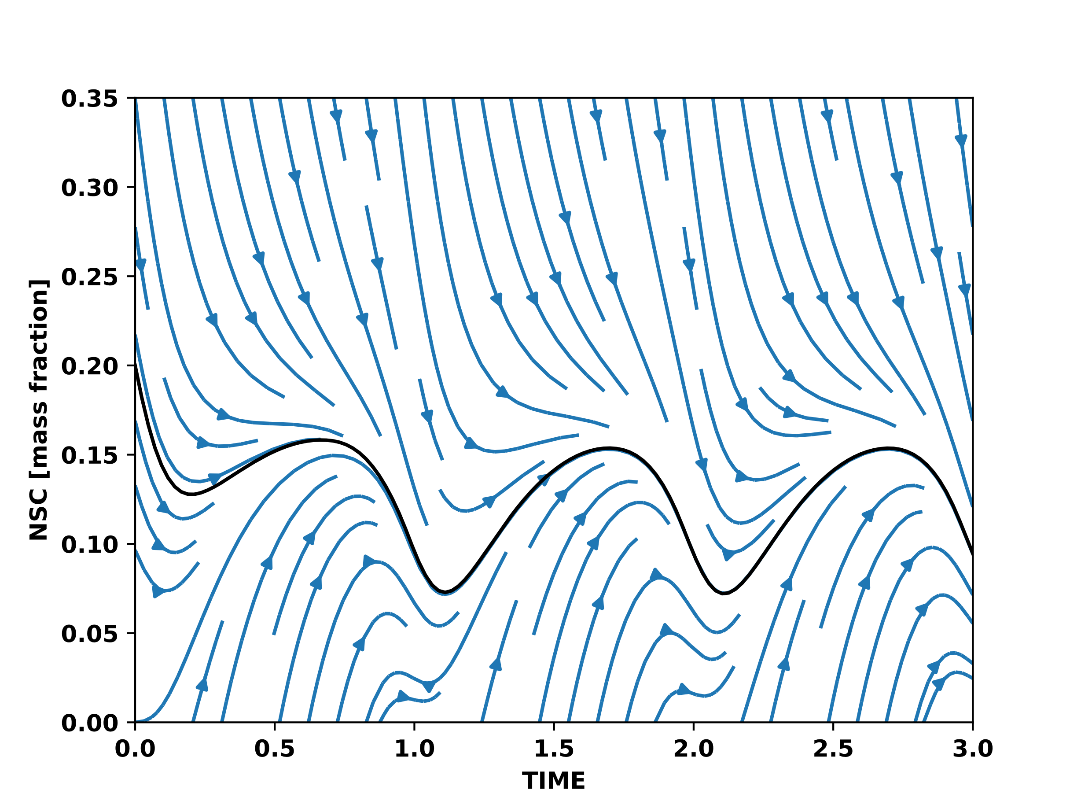
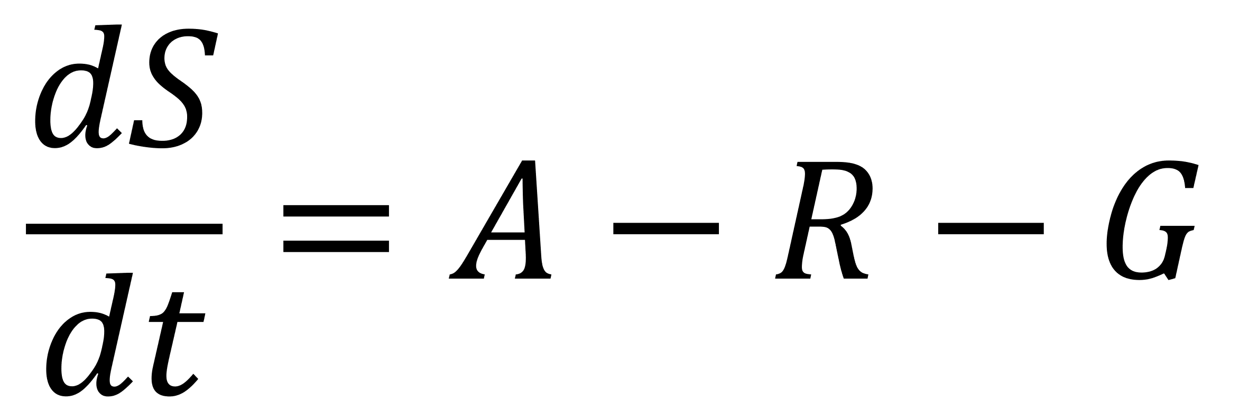
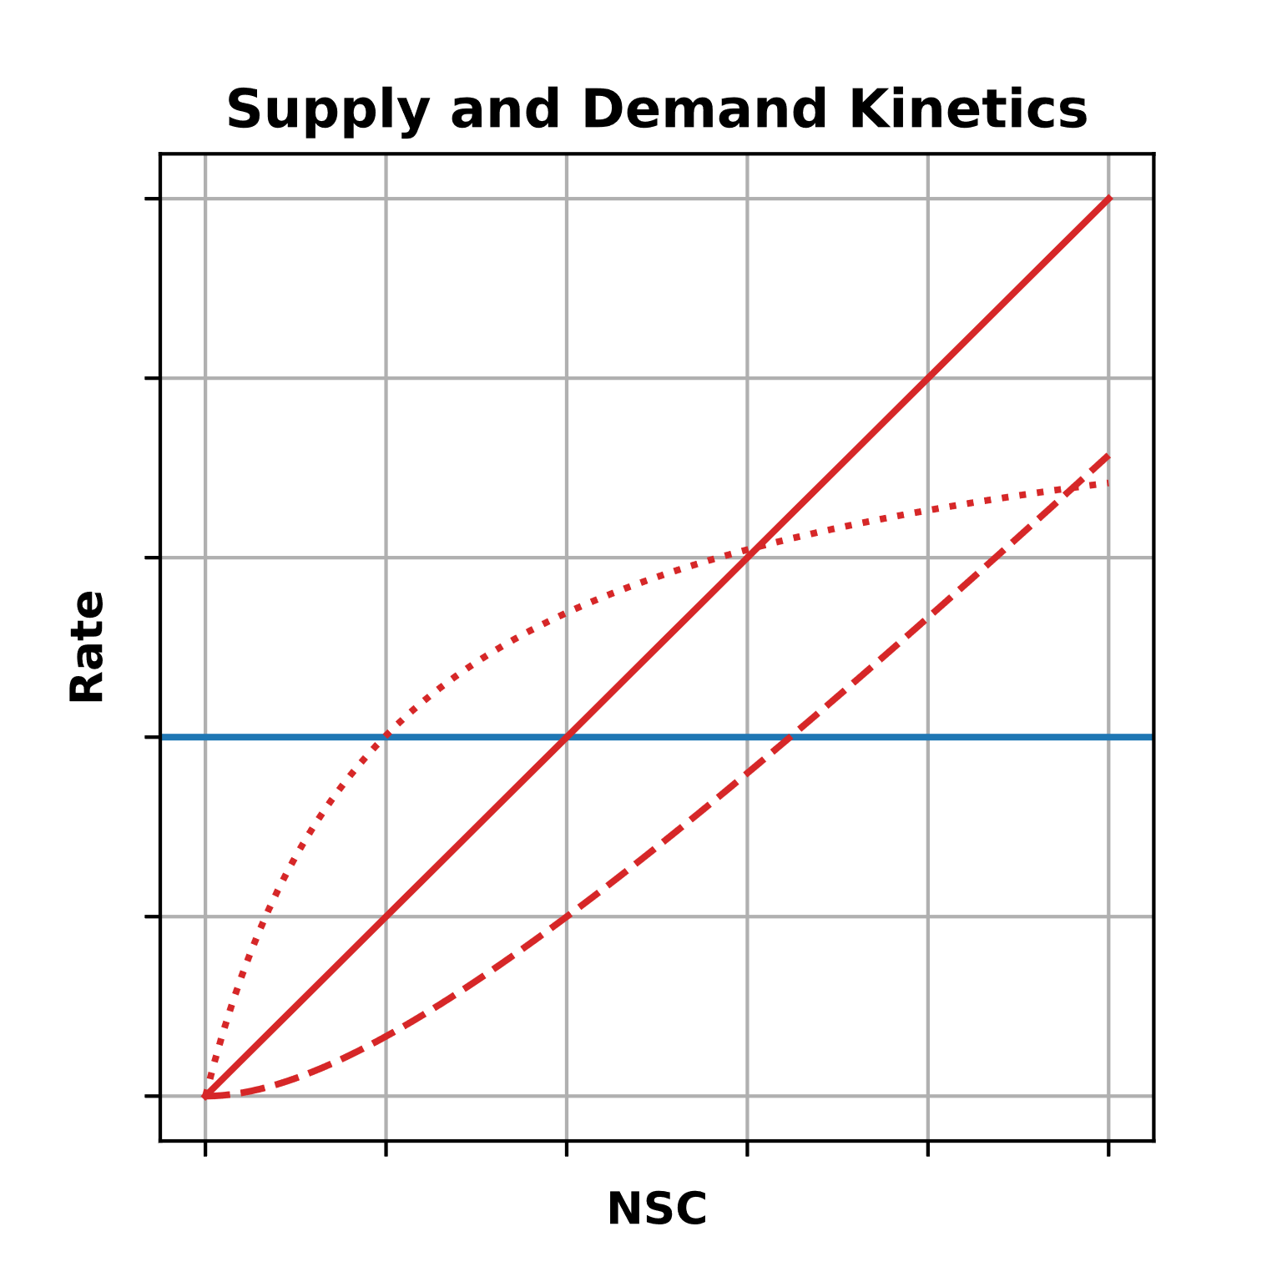

Slide 16
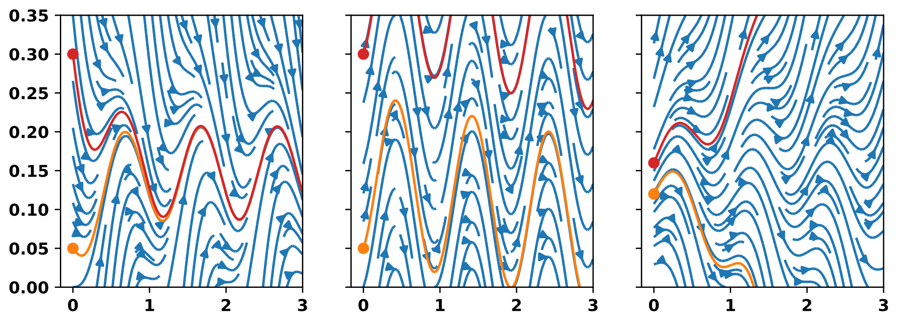
NSC (mass fraction)
Time (y)

Slide 17
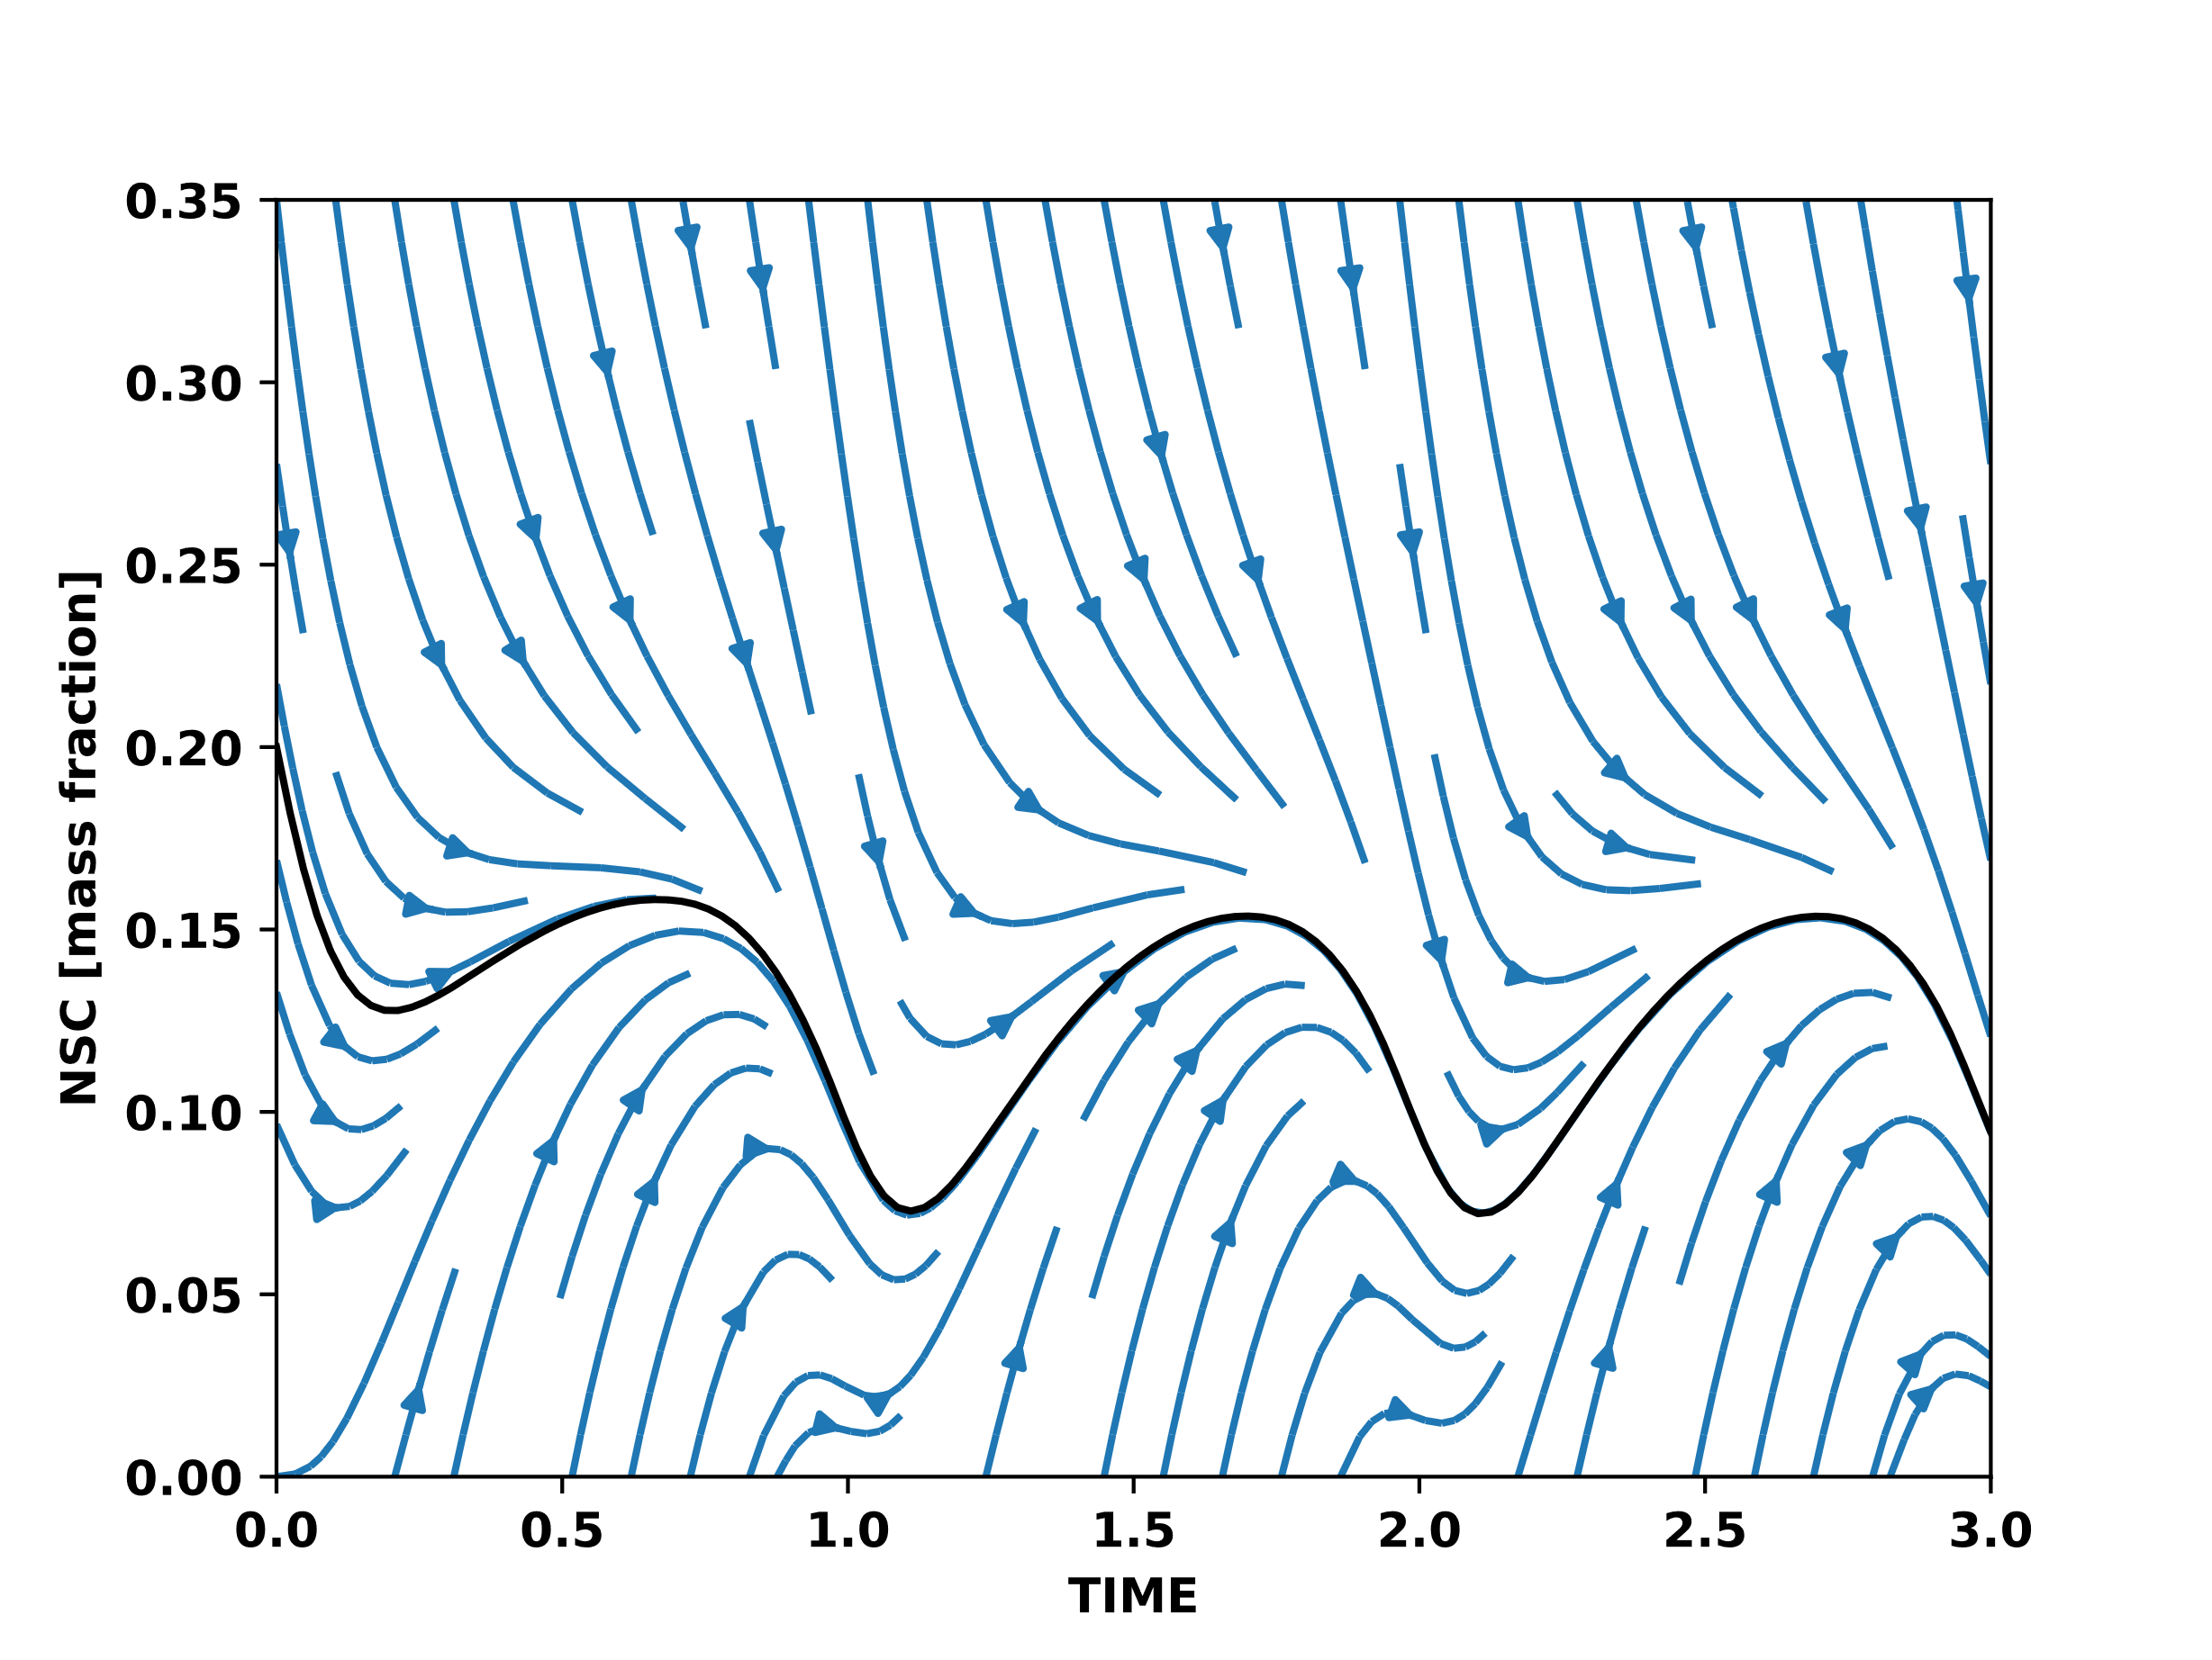
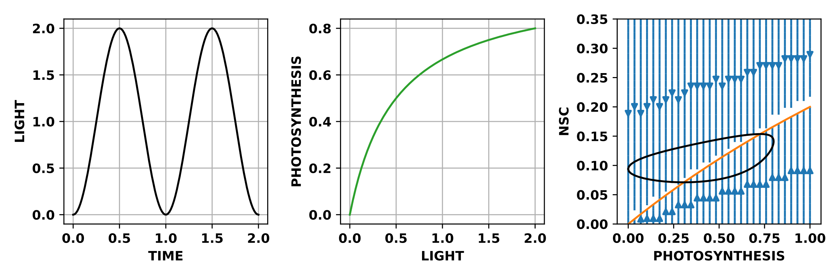

Slide 18
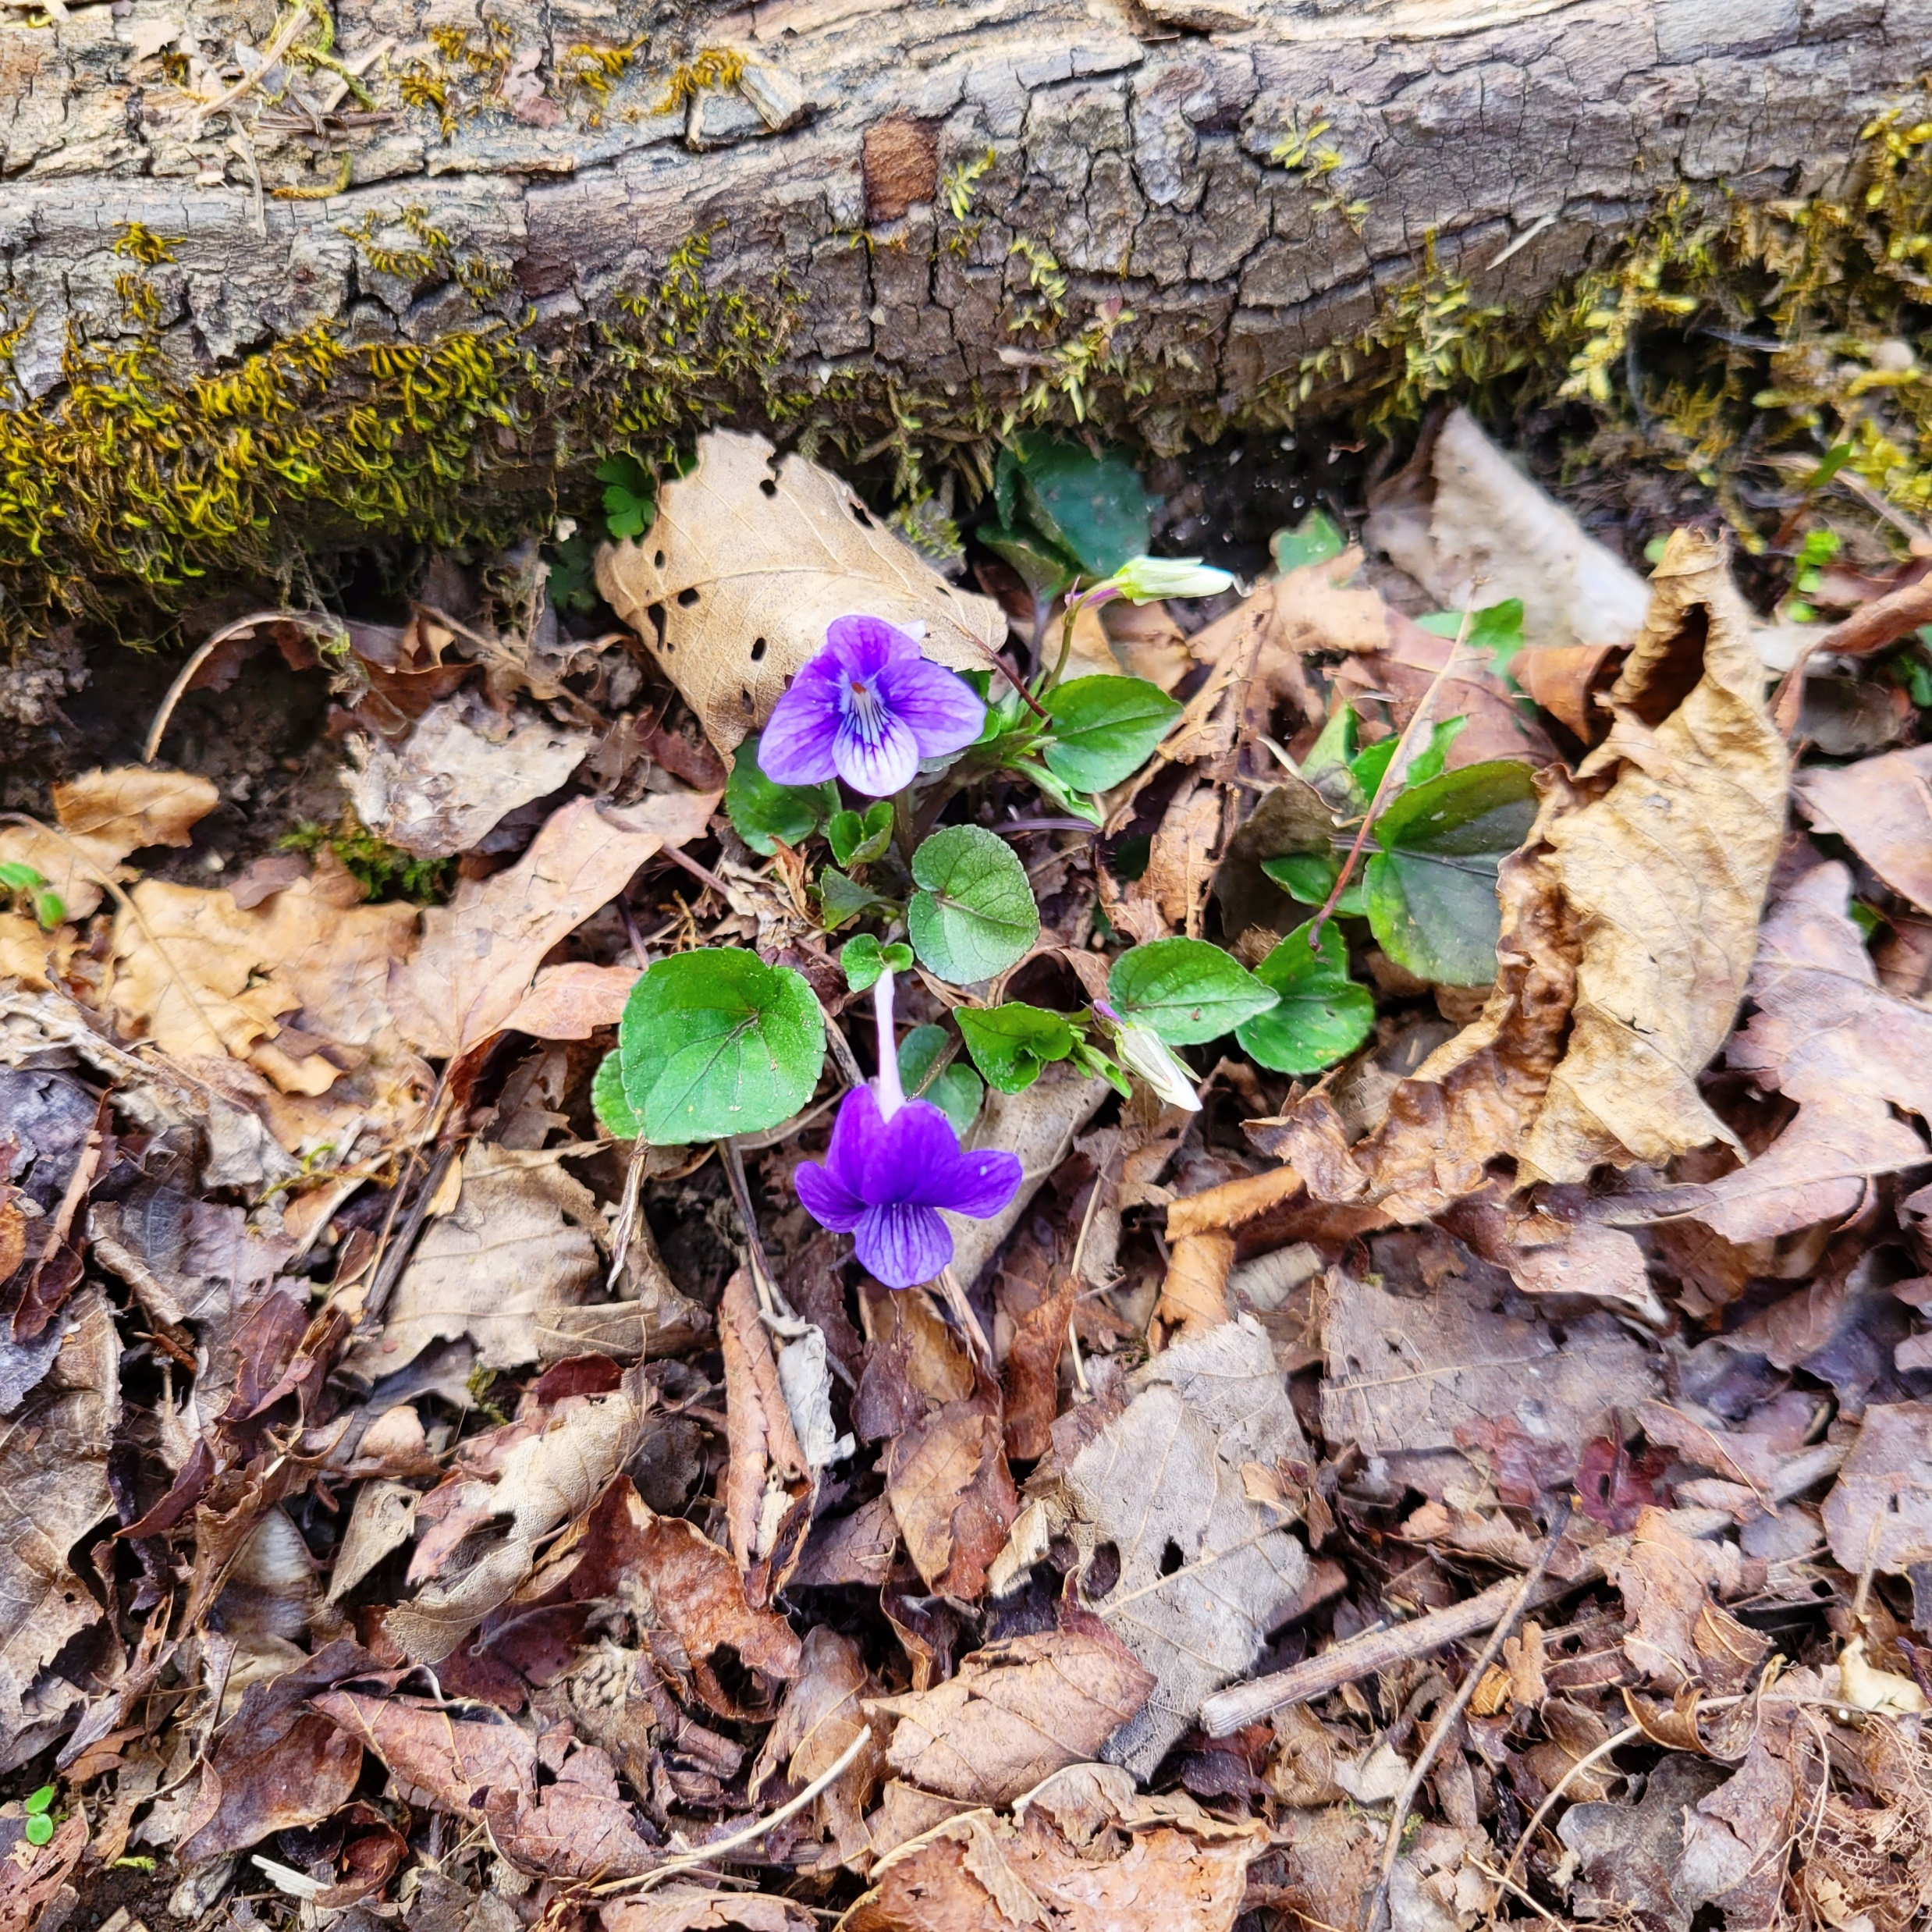
Some text

Slide 20
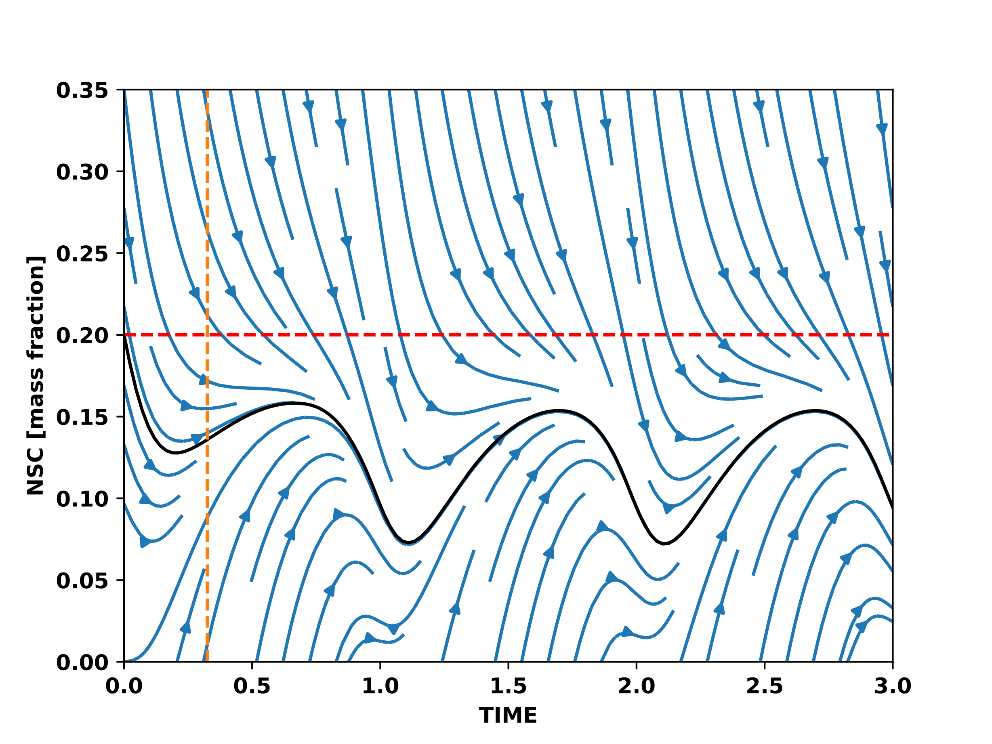
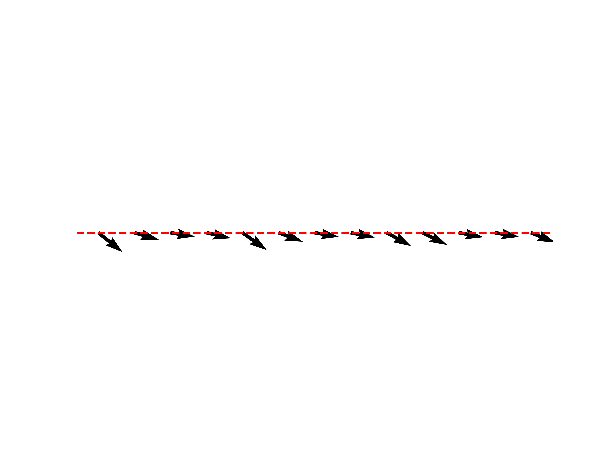
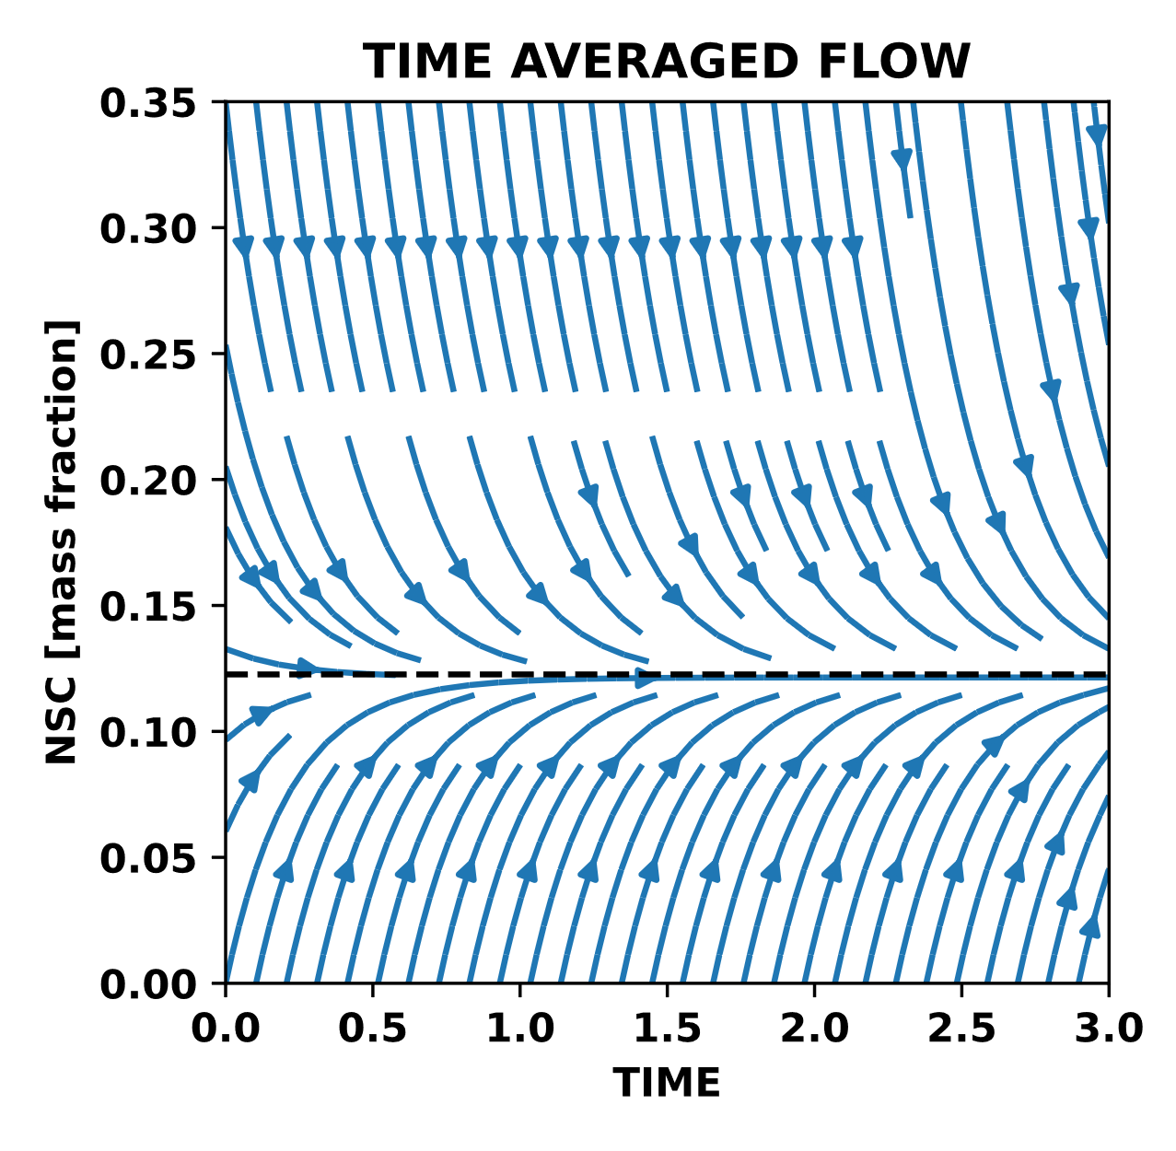

Slide 21
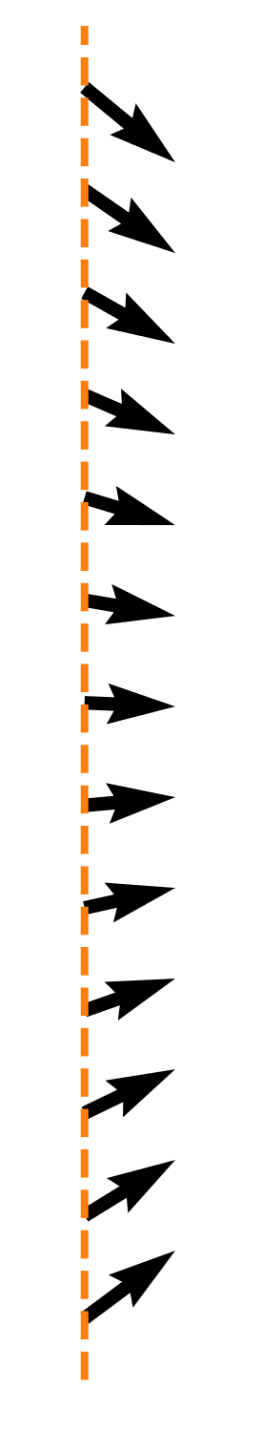

Slide 22
